Slide 1
Making Better PCBs
A start-to-finish guide for getting started designing quality boards

Slide 2
Meta: About this talk
Kinda wordy! (Sorry)
Breadth over depth
Laid out for later reference.

Slide 3
The General PCB Design Process
What does it need to do?
Initial Part Selection
Draw schematic
Lay out pcb
Redo everything
Prep for fab

Slide 4
The Process: Design Decisions
Inputs?
Output?
Sensor Data
Microcontroller? Analog?
One-off or product?
Where will the board be used?
What parts simplify all your work?
Notes:
If your device is measuring sensor data, how do you get the data from it?
If you’re developing a one-off, you can usually get by with poor designs, terrible yields, and bad practices. You only need it to work once.
If you’re developing a product, best practices for manufacturing should be considered from the get-go.

Slide 5
Your first board:
Will probably be wrong.
Make it cheap
Make it useful
What you’ll mess up
Part spacing + orientation
Footprints
Via/header size
Bad part choices
Assembly
THAT’S OK!

Slide 6
Board one: How to learn from it
Build 2 copies
1 to fix at all costs
1 to verify corrections or failures
If possible, save 1 as a “control” layout.
Make notes on spacing/sizes
Avoid adding microcontrollers
Make notes of other difficulties
Notes:
Why no micros? Adds lots of complexities to determine failure.
Bootloader
Programmers
Toolchains
Code
Often high-speed signals for clock and progamming headers

Slide 7
Picking your design tool
Cost to you
Features + Upgrade path
Ease of Use + Learning Curve
Community + Documentation
Existing parts
Cost to others
Every tool sucks
Notes:
No matter what tool you use, make sure that the tool works for you.
Features:
Make sure that the tools you need later are available at a cost you can afford
Worth looking forward to avoid a large time investment on multiple design tools.
Existing parts helps when you’re getting started, but shouldn’t be considered a “key” factor. With experience, you’re likely to rely mostly on your own libraries, not community. (More later)
Cost to others:
Open projects are less-open if no one else can open the files
However, community benefits from having the project exist at all, even with non-usable source files
Someone can port it from one tool to another
In the end, do what you need to make projects happen.

Slide 8
Picking Your Design Tools
Clearly biased suggestions:
KiCAD
Free, open source
Great community
No design restrictions
!! Quirks, bugs, version-specific issues
Rapidly improving

Slide 9
Picking Your Design Tool
Eagle
Easy to get started with
Great community
Well developed community libraries
de-facto standard in the Arduino community
!! VERY stagnant development.
!! Lots of restrictions on free versions
If in doubt, try KiCAD first.

Slide 10
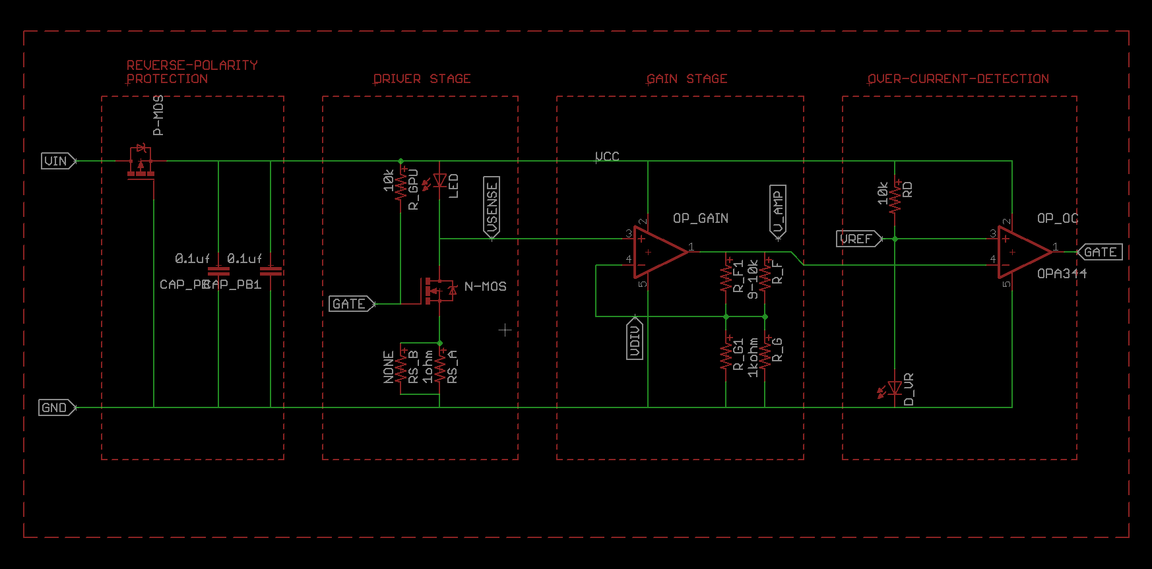
Schematic layout!
Notes:
This schematic is from my Bigger Better Breadboard project :
https://github.com/tekdemo/bigger-better-breadboard/tree/master/LEDs

Slide 11
Glossary: Schematic
Component
A part, such as a resistor or integrated circuit (IC)
Net
A name for a particular signal
Can connect many wires, ICs, or board layers.
Schematic
The symbolic connections between parts.
Connects Net, not "traces".

Slide 12
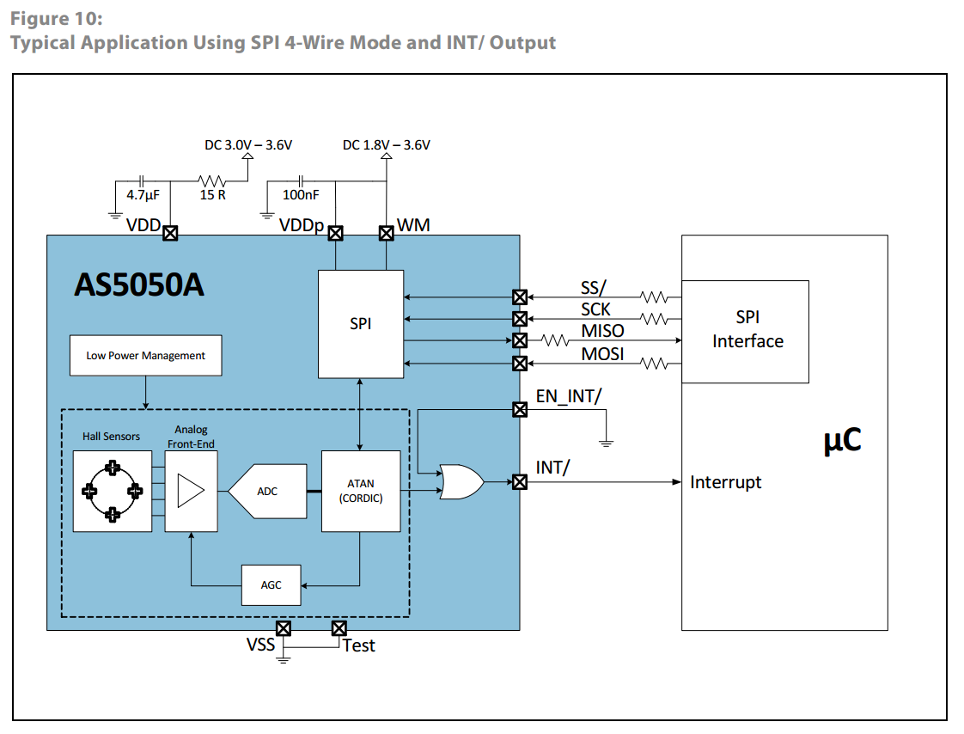
Schematic
Datasheets: A dummies guide
Provide suggested components
Details connection interfaces and options

Slide 13
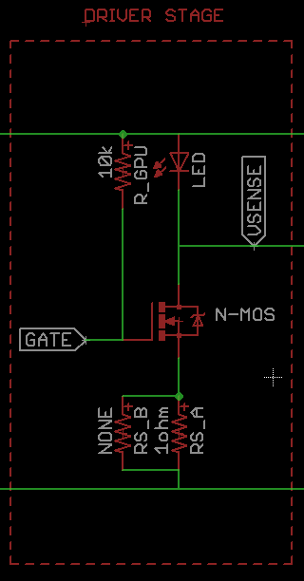
Schematic: Name nets
Defaults are stupid: n$7
Human-readable means human-checkable
Can be checked during PCB Routing too
Allows meaningful labels
Notes:
Some design tools (eg, KiCAD) can also show net names ON the trace during routing. This can make it trivially easy to keep good track of your routing.

Slide 14
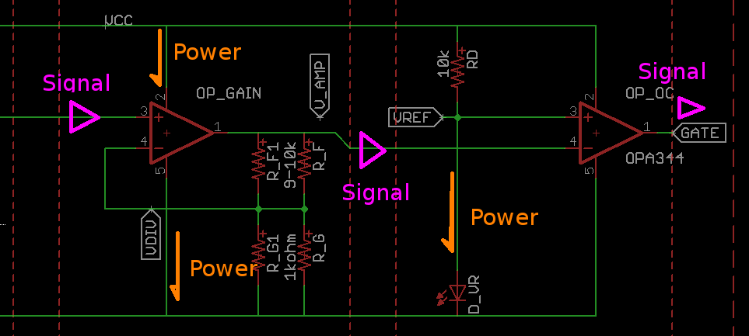
Schematic: Conventions
Power flow goes top to bottom
Signal flow goes left to right
Most parts follow this (not all)
Notes:
Following conventions will reduce mental time, improve checking
Helps prevent footprint errors later
!! Always check community footprints. This schematic actually had op amps with Power on bottom, and GND on top. Wasn’t caught, and was a pain to correct.

Slide 15
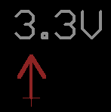

Schematic: Conventions
Active low nets: Prefix name with “n”
eg: nEnabled, nDisabled, nActive,nFloating
Avoid long lines to power/ground
Use labels or Power/Ground symbols
Use descriptive names to avoid confusion
PWM_RED_LED
I2C1_SDA
UART1_TX_OUTPUT
Notes:
Active low nets usually come from pins with internal pull up resistors
Very handy, since you can often leave them disconnected if you don’t need to use that function.
Net names are often helpful to match for programming reference. For mono-directional ones, mark them with output to make it clear

Slide 16
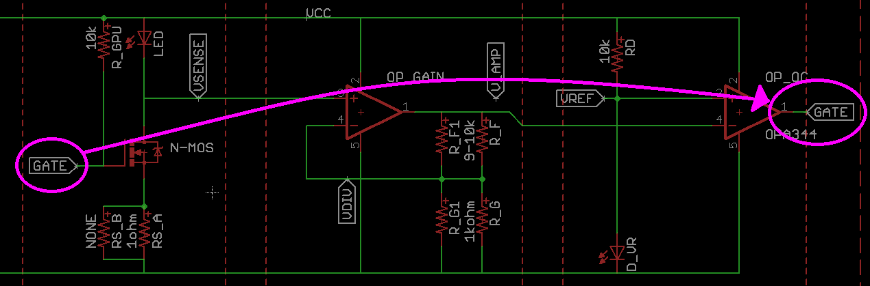
Schematic: Don’t worry about lines
Use net names and labels
Reduced clutter = better checking

Slide 17
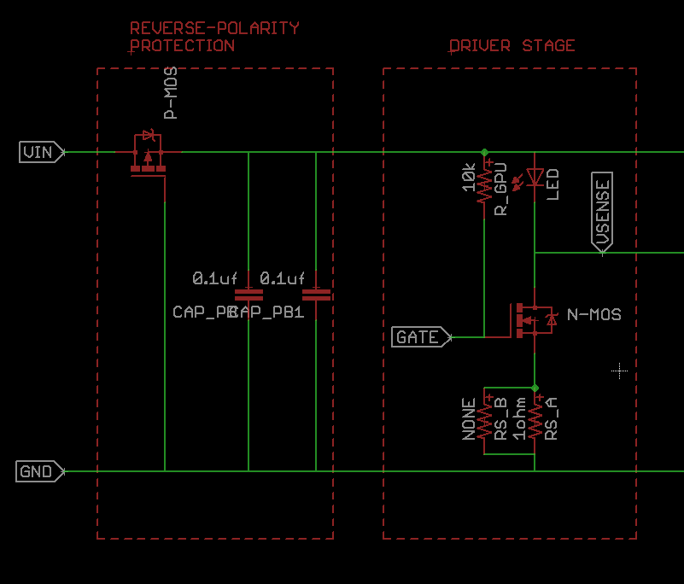
Schematic:Create Functional Blocks
Group related parts
Label nets between blocks
Notes:
Good boards start from a good schematic
Helps you generate logical places for test points later
Helps indicate important signals

Slide 18
Schematic: Tips for Beginners
Add Extra status LEDs
Add one per power net
One for microcontroller to blink/toggle
Add test points
Give you a place to test voltages
Makes cutting/rerouting traces easier
Add in schematic so you don’t forget
Make UART signals easy to fix
Add jumpers or test points to swap pins

Slide 19
Libraries
Broken into 3 parts
Symbol
Schematic-side
Connects internal and external nets
Device / Component
Connect Symbol to Footprint
(or, connects nets to pads)
Often has multiple footprint options for identical symbols
Footprint
Layout Side
Connects pads to traces

Slide 20
Libraries
Community libraries:
Trust, but verify
All libraries have an error
Won’t have every part
Can get you started quickly
Notes:
Remember: You WILL find the error in a library. Eventually.

Slide 21
Libraries
Make your own!
You’ll need to
You’ll get the hang of it
Can save you work
Can (usually) be trusted
Notes:
Suggestion:
1 library for new and untested footprints tested yet. Put any new footprints in this.
Make 1 library for known, trusted footprints. Only copy stuff over once you’ve been happy with the results on a pcb

Slide 22
Design Decisions: Providing power
Off board power
Such as USB, 5V wall wart, or Arduino
Cheap + easy, but tethers your project to outlet
Ideal for many projects
Batteries
Lipo? NiCAD? NiMH? Alkaline?
Large voltage ranges
Charging?
Forces low-power designs
Notes:
Be mindful of battery voltages, since it can often drive the component selection for other parts of your system, especially voltage regulation

Slide 23
Design Decisions: Regulating power
Linear Regulator
Pro: Cheap and simple
Con: Watch the voltage drops
Con: Can be hot and inefficient
Switching Regulator
Con: More parts, and much more complex
Con: Often needs more PCB area
Pro: Can provide large voltage drops efficiently
Pro: Can increase voltage source provides

Slide 24
Design Decisions: Regulating power
Unregulated battery power
HERE BE DRAGONS. May cause unexpected issues. Sometimes serious.
Voltage range will drive component selection
Can be good for simple blinky or analog circuits

Slide 25
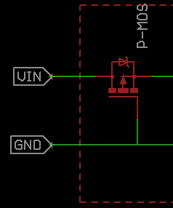
Design Decisions: Regulating power
Input Power Protection
Good idea when moving past prototype stage
Can be very simple:
Reverse Polarity can be 1 part
Overcurrent or overvoltage can be 1 IC, or a few parts
Some ICs do everything for you
Notes:
Read up on good protection things. Be mindful of
Current going through protection circuit
Voltage across protection circuit
What your circuit realistically needs
Failure modes of over-voltage over-current, reverse polarity. Can range from magic smoke release, to not working until it’s plugged in properly.
If giving a board to others users, a keyed power connector can also help reduce errors, and alleviate need to do some power protection

Slide 26
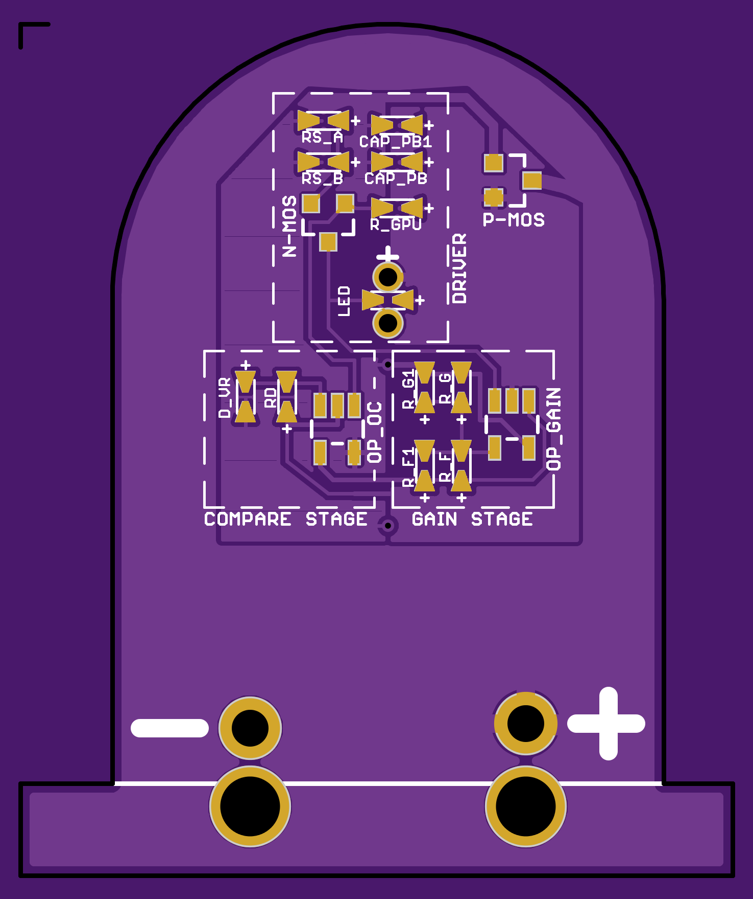
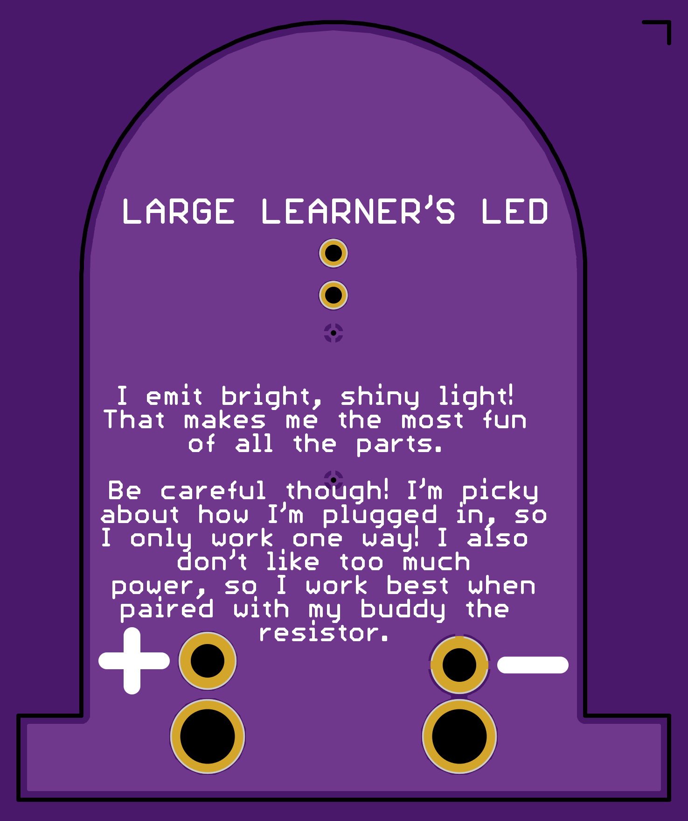
PCB Routing: Physical Connections
Notes:
Again, LED Board for consistency https://github.com/tekdemo/bigger-better-breadboard/tree/master/LEDs

Slide 27
PCB Routing: Glossary
AKA Board Layout
DRC: Design Rule Check
Uses specifications to verify manufacturing requirements
DFM: Design For Manufacturing
Guidelines and suggestions for preventing errors
Usually not enforced by design tool
Covers wide selection of design and layout areas
Critical as volumes and complexity increases
Notes:
More on DFM Later.
Can often be ignored for one-offs or short runs

Slide 28
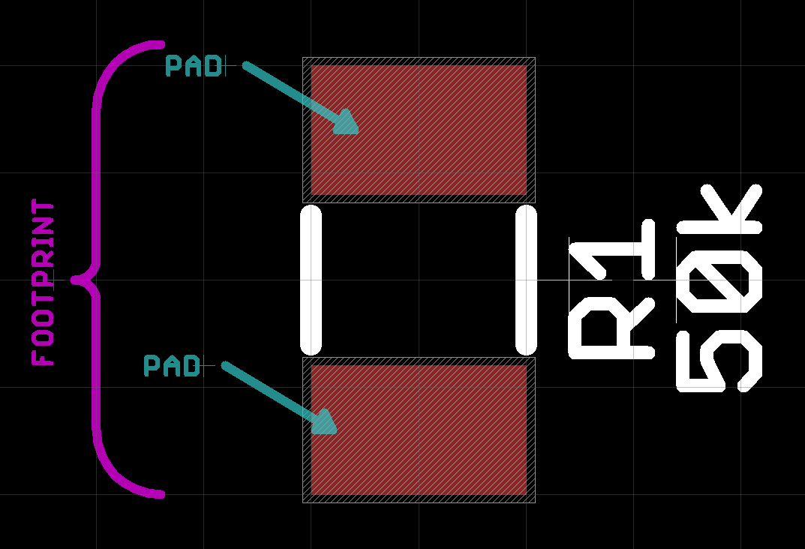
PCB Routing: Glossary
Stop Mask: Indicates a section of the board that should be exposed
Pad: A small exposed section of copper.
Typically refers to where you’ll be attaching a part
Footprint: A set of pads that match a component’s pin arrangement

Slide 29
PCB Routing: Glossary
Package: Physical size and shape of a component
Most parts have multiple packages
Pinout
How the nets from an IC connect to the pads
Parts with the same footprint can have different pinouts.
Notes:
Pinouts:
Very common to have pinout variances on voltage regulators, transistors, and other points.
Can be very confusing if you’re not careful

Slide 30
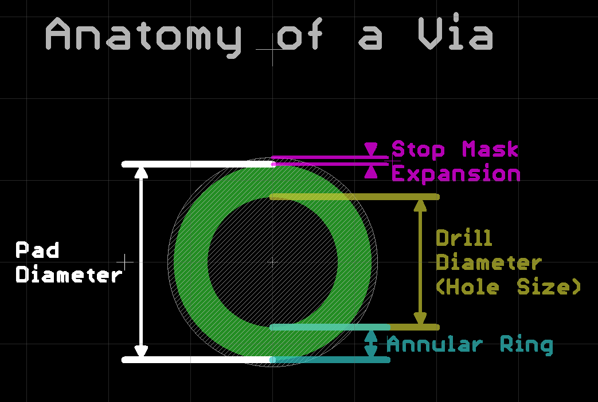
PCB Routing: Glossary
Notes:
Typically, design tools expect annular ring and Mask Expansion as a DRC spec. Then, with a given hole size, they calculate the pad diameter. Conversely, for specific holes you can often specify pad diameter and drill size, and the design tool will only complain if the annular ring is too small.
Typically, the drill diameter you specify is the “finished” hole size, after all fabrication processes. After that, the only variation will be the fabrication tolerance (Often around 2-5 mil).

Slide 31
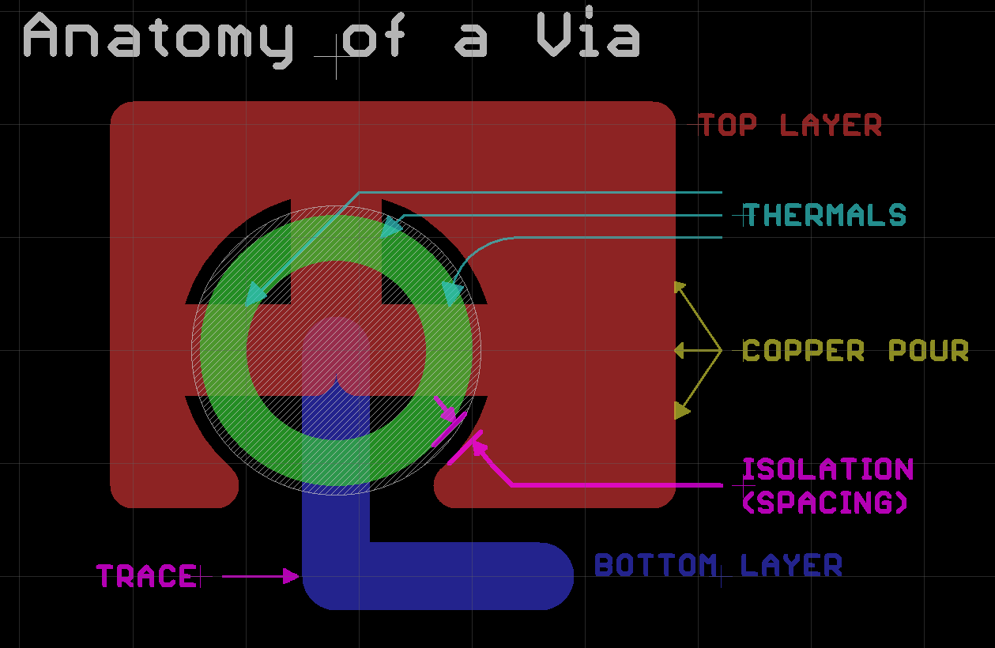
PCB Routing: Glossary

Slide 32
PCB Layout: Design Rules
Critical specs:
Minimum Drill size
Annular Ring
Trace Spacing
Trace Width
Less Critical specs
Board-edge clearance
Mask expansion/retraction
Minimum mask web
Notes:
The annular ring serves to simplify fabrication tolerances. It covers most errors that can go wrong, including layer misalignment, drill tolerances, and a few others.

Slide 33
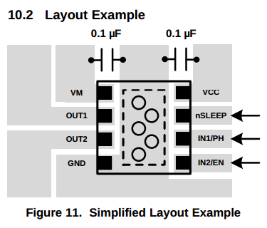
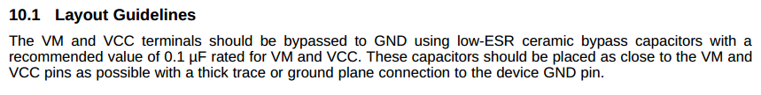
PCB Layout:
Datasheets: A dummies guide
If routing matters, ICs often have examples and notes.
High Current
RF
Low-power
Analog
Notes:
More on special signal types later.

Slide 34
PCB Layout: The general process
Separate parts into blocks you made earlier
Organize parts
Route power and ground
Route Signals
Combine blocks on desired board shape
Route power and ground
Route Signals
Make corrections

Slide 35
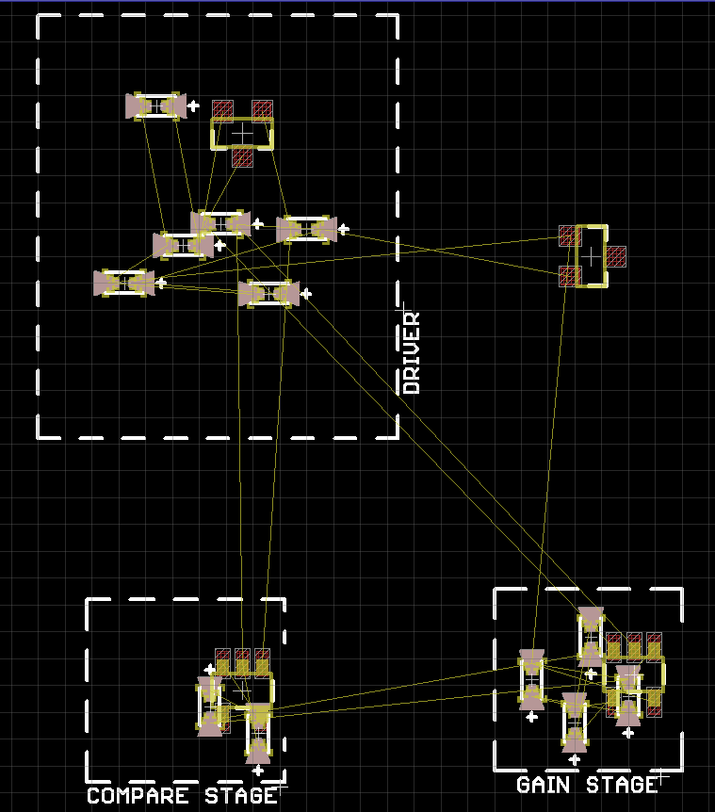
PCB Layout: Forming Blocks
Sort components out
Just like the schematic!
Notes:
Usually Reduces Layout time
Improves error checking
Doesn’t always work
Mechanical constraints
Some designs are not easily grouped

Slide 36
Design Decisions!
Components on one or both sides?
Both: Can Ease Routing
Both: MUCH harder to assemble
2 or 4 layer board?
2 layer is less expensive
4 layer makes routing much easier
4 layer may not be an option
Notes:
In most cases, trying to get all SMD components on one side is a good idea.
Difficult or impossible to reflow parts when they’re on both sides
Often limits you to hand-assembling one side of the board
In mass production, 2 sided assembly services is much more expensive.

Slide 37
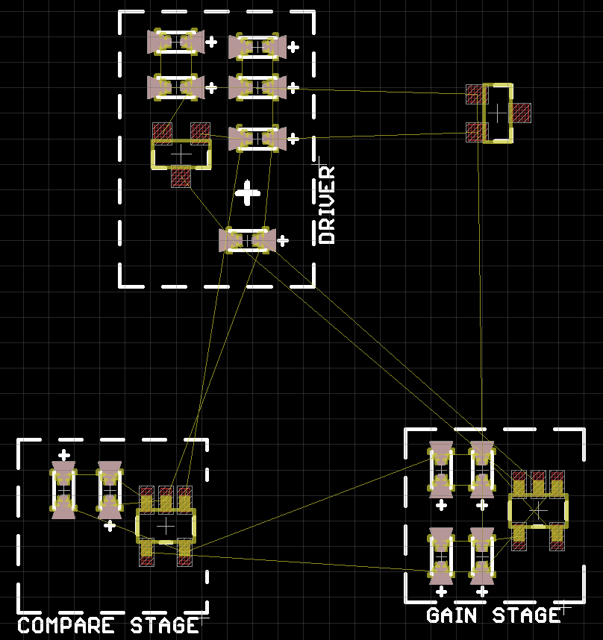
PCB Layout: Routing Blocks
Untangle Airwires
Minimize crossover
Minimize routing length

Slide 38
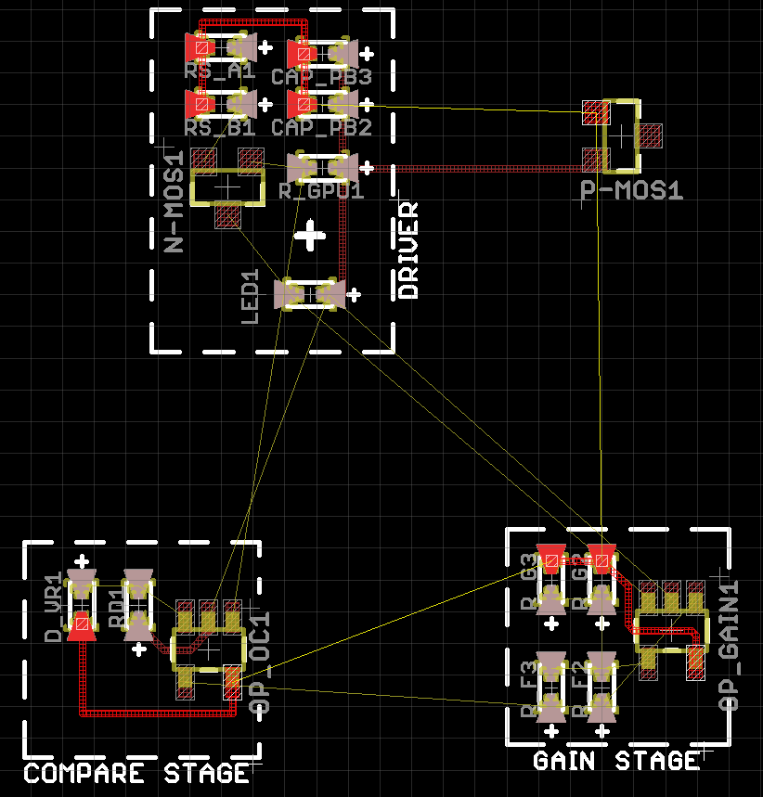
PCB Layout: Routing Blocks
Power and ground first
Bypass caps second
Important Signals
Analog
communication
high-power
Everything else

Slide 39
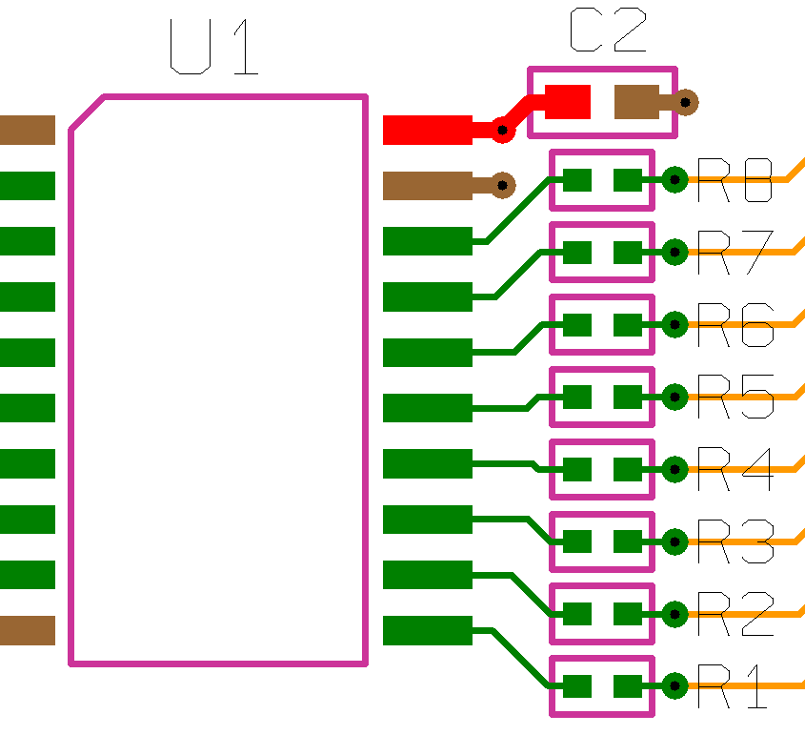
PCB Layout: Bypass caps
Magic sprinkles of electronics
Every IC should have one
Requires intentional routing
Minimize “loop area” between IC Power, IC Ground, and cap pads
Avoid vias (generally)
Should be physically close to IC
http://blog.optimumdesign.com/how-to-place-a-pcb-bypass-capacitor-6-tips
Notes:
Worth doing some research. Especially if running specialized ICs, high frequency, or mixed-frequency circuit boards.

Slide 40
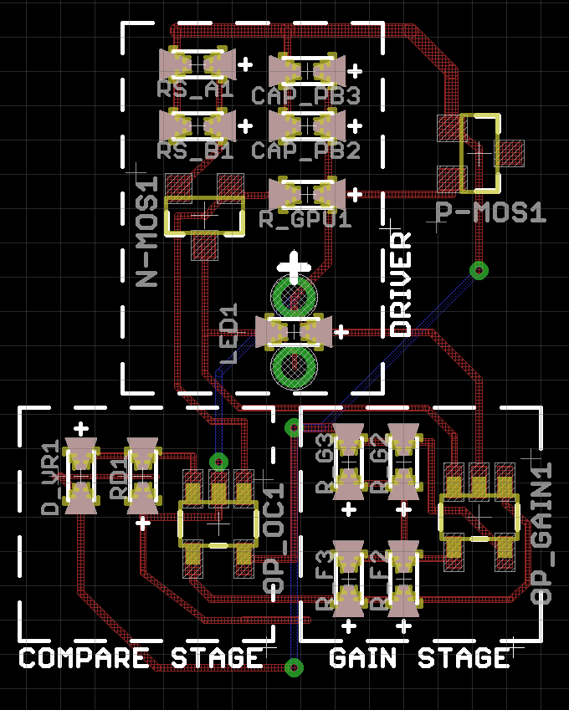
PCB Layout: Connecting Blocks
Arrange blocks
Minimize airwire distance
Plan for mechanical
Odd PCB shape?
Offboard connections?
Mounting?
Connect!
Power, then signals

Slide 41
PCB Layout: Routing Strategies
Short + Long
Put Parts + short traces on top
Long connections on bottom
Ground pour on bottom
Up/Down + Left/Right
Put up/down traces on top
left/right traces on bottom
Varies by design!
Notes:
These two help a lot when getting started.
Many ICs favor particular strategies, or force their own Some types of signals force specific strategies and priorities (discuss later)
Odds are, at this point you’re going to re-do routing. That’s fine!
Usually you’ll discover a much more effective way to route the boards.
Will often be dramatically simpler than the first time.

Slide 42
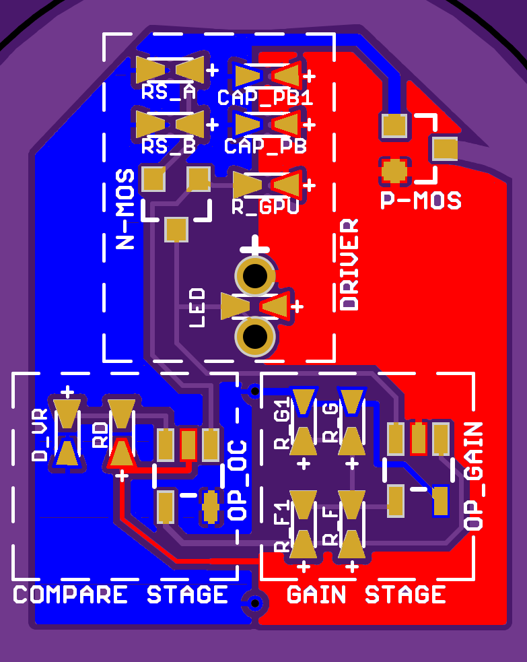
PCB Layout: Design Decisions
Ground/Power Planes?
Route first! (for now)
4 layer Routing Strategy:
Top: Parts + short connections
Ground plane
Positive power plane
Bottom: Longer connections
Notes:
Route first! Prevents common mistakes with ground planes
Poor ground connections
disconnected sections
long, zig-zag traces
4 layer
Super easy to route
Difficult ( but not impossible), to make terrible ground planes

Slide 43
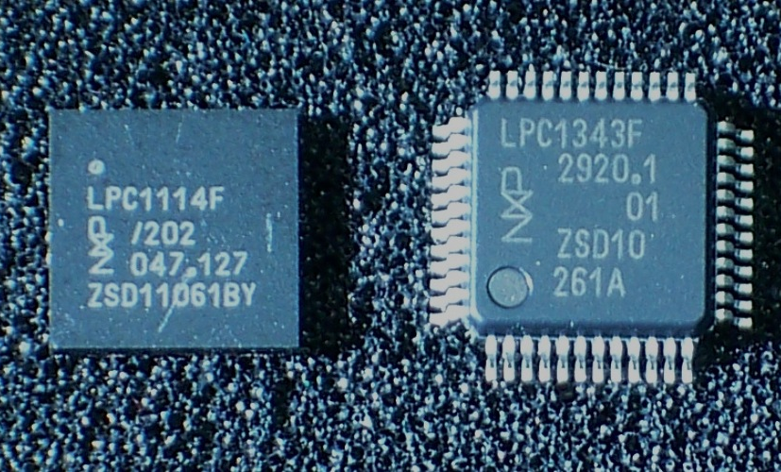
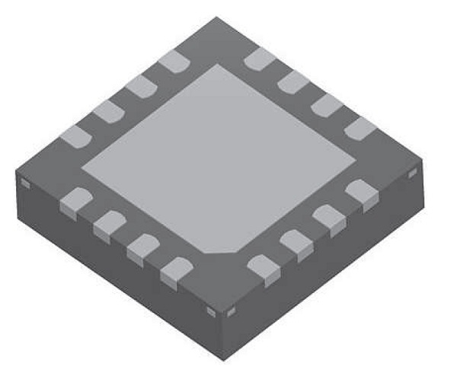
PCB Layout: Design Decisions
Surface Mount Parts
Lots of advantages
Need to use them eventually
Beginner Friendly
Passives: 1206, 0805
IC: Leadless packages, MSOP-*, SOT-*
Less friendly
0402: Really tiny and hard to place
BGA, pitches 0.5mm and lower
Notes:
Fine-point pins are really tricky. They hold solder, and are hard to de-bridge.
Leadless packages are surprisingly easy to rework if you screw up assembly. Just remove excess blobs.

Slide 44


PCB Layout: Design Decisions
Via Tenting?
Thermals?
Assembly consideration
Space for rework
Leave room for silk
Heatsinks?
Voltage Regulators
Motor drivers
Notes:
Tenting:
pro: prevents assembly mistakes
pro: looks nicer
Not tenting:
con: Prevents access for debugging
Improves access and debugging
Thermals:
improve reflow on pads
Not critical on vias
cons: Can reduce current flow when handling high-current traces

Slide 45
PCB Layout: Routing Busses
Bus: A group of signals performing the same function
Common for chip-to-chip communication
Should be routed at the same time
Try to keep together
Length differences may matter
Consult routing guides for the protocol
More/less picky, voltages, pull ups, oh my.

Slide 46
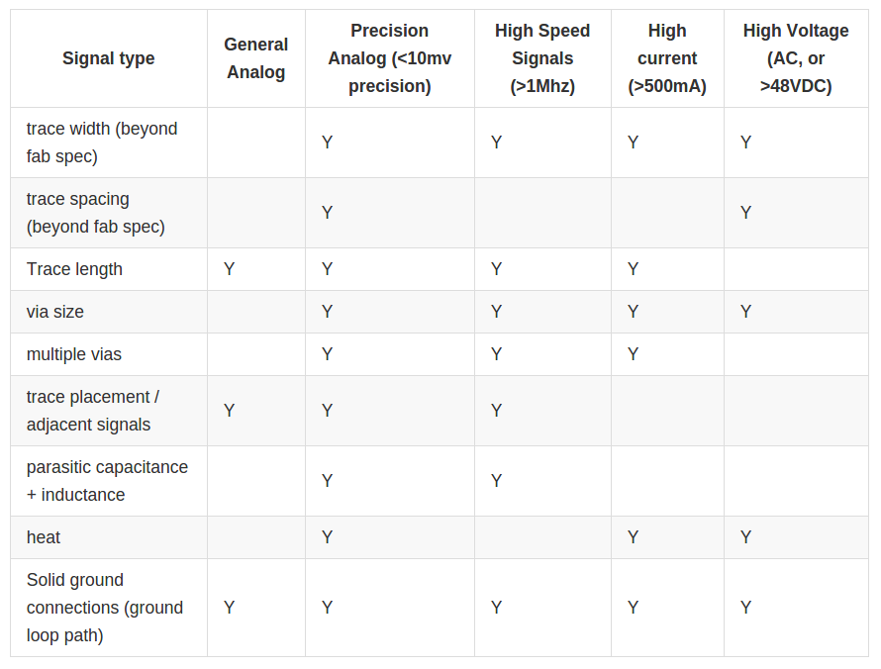
Routing: Notable Signal types
General analog:
Typical hobby-level stuff, with voltage swings of 100+mV causing no issues.
Greater than/less than voltage comparisions usually fall in here
Precision Analog:
Usually for fine logging or measurements.
High Speed:
Common for clock signals, Wireless radios, some serial busses, video signals
Notes:
Datasheets and whitepapers will help when configuring routing for all of these signals

Slide 47
DFM: Design for Manufacturing
Or, How to minimize fabrication problems
Fab specs are minimums
Opt for larger traces, and larger spacing
Increase ground plane isolation
Avoid placing parts needlessly close
Doubly important for open designs
Can’t always plan for specific fab specs/QC
Notes:
For open designs, any fabrication errors might be seen as design flaws on your end. Don’t frusturate the community!

Slide 48
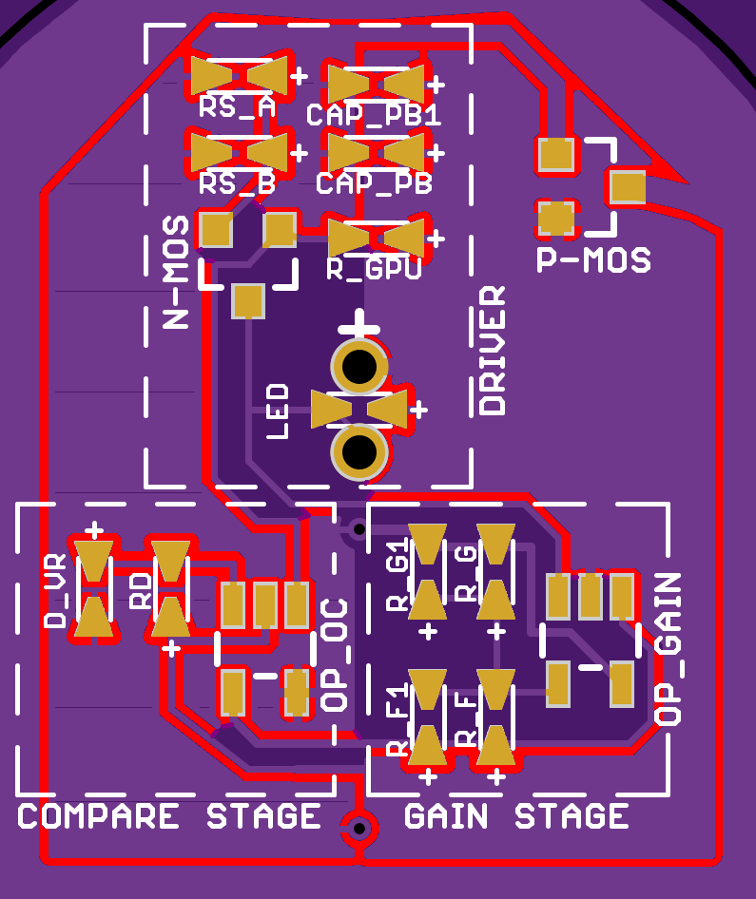
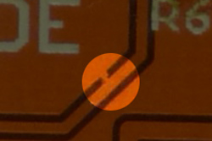
DFM: Ground Plane Isolation
Set above fab min spec
Touches lots of traces
Hard to find and troubleshoot
Example Short:
Notes:
When routing, you’ll naturally avoid placing traces really close together, and making good use of space. However, design tools by default, put ground planes at the DRC spec, which is the minimum fab spec. Don’t let that ruin your meticulous DFM efforts! Use the minimums when needed, but avoid for your ground pours.
The pic above (red) shows the ground plane contact with other signals. That’s a lot of places for things to go wrong. As designs increase in complexity, this becomes increasingly more difficult to troubleshoot.
To adjust this, check the “Isolation” settings in the DRC or Polygon/copper pour setting. A good start is fab spacing spec +25% or so.
Picture from http://www.sebastians-site.de/ and http://dangerousprototypes.com/docs/Get_your_PCBs_made

Slide 49
Fabrication: Getting prepped
Run DRC
Double check pinouts
Verify availability of components
Put date, version, and name on board
Mechanical Concerns
Mounting holes?
Enclosures?
Part sizes?
Notes:
Often overlooked on mechanical concerns is interference with tall parts. Very important if your board has an enclosure.
Some design tools (including KiCAD!) can generate 3D models of your parts, and you can import them into 3D cad models

Slide 50
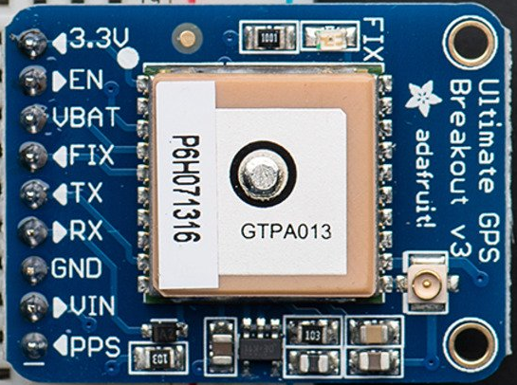
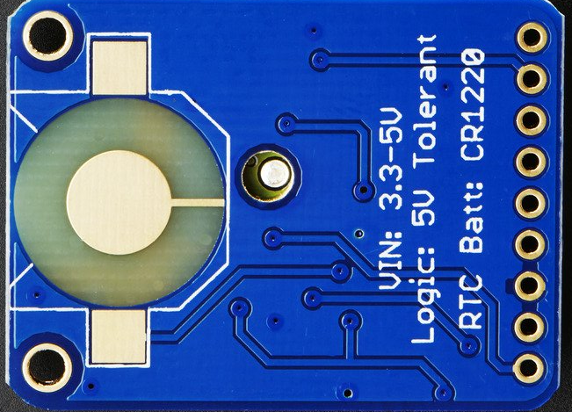
Fabrication: Getting prepped
Clean up silkscreen
Component names
Label off-board connections
List power input voltage ranges
Mark polarity of components
Make silk readable size ( >0.035”)
Notes:
https://www.adafruit.com/products/746
Extra credit for Adafruit adding IO directions for their inputs and outputs.

Slide 51
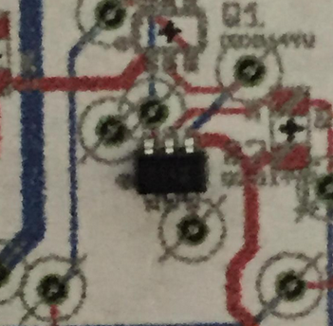
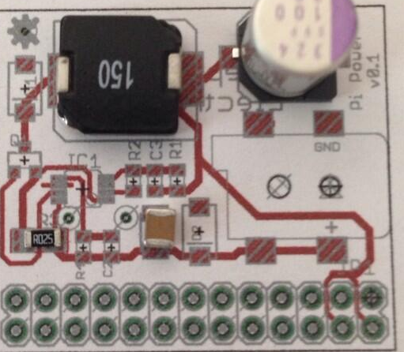
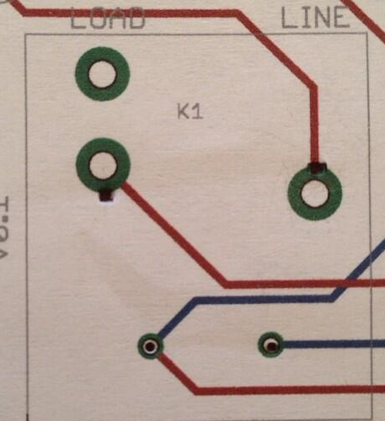
Fabrication: Getting prepped
1:1 Scale Printout
Notes:
Easy way to double-check a lot of potential board issues.
On the right, is a relay where the footprint didn’t match the actual part. Money saved with a piece of paper.
Pictures from https://twitter.com/nwsayer

Slide 52
Fabrication: Ordering Boards
Run the CAM processor
(usually)
Generates gerbers and drill files
Verify expected drill format for your fab
Drill formats are stupid.
Verify board shape / outline gerber
Dimension layer on Eagle
Edge_Cuts on KiCAD
Mechanical 1 on most other tools
Notes:
Some fabs can accept certain design files directly
Oshpark accepts Eagle,
Some fabs accept ORCAD or Altium files
If possible, preview drill files with the tool your fab uses.
Not always possible, since most fabs have custom tools

Slide 53
Fabrication: PCB Layers / Gerbers
Simple files corresponding to a single part of the fabrication process
Copper Placement
Hole placement
Solder resist placement
Silkscreen printing

Slide 54
Fabrication: PCB Layers / Gerbers
Complexities come from format ambiguity
Plated drills?
How is the edge defined?
How is the drill format handled?
Positive or negative internal layers?
If in doubt, ask your fab!
Folks get paid to help you. Take advantage!
Notes:
Some fabs require multiple drill files, others require singular drill files
Even with a known format, the fab can interpret things in certain ways
How the edge is defined on the edge-layer
Which layer defines the edge

Slide 55
Assembly: What you’ll need
A decent iron
Solder
Desoldering braid
For SMD work:
Fine point stainless steel tweezers (Walgreens)
Solder paste (Chipquik is best. cheap Ebay/Amazon paste works, but not suggested)
Stencil?
Notes:
For irons, avoid the Firestarter ones for 10-15 bucks.
Minimum is a ~$35 Weller iron from ebay. Get a ⅛ chisel tip
Suggested irons are Hakko or Metcal. If you’re sticking with the hobby, it’s worth paying for
Kapton stencils are cheap, make for easy work, and very reliable. Highly suggested. Also ship faster than PCBs, so it’s unlikely to cause delays.

Slide 56
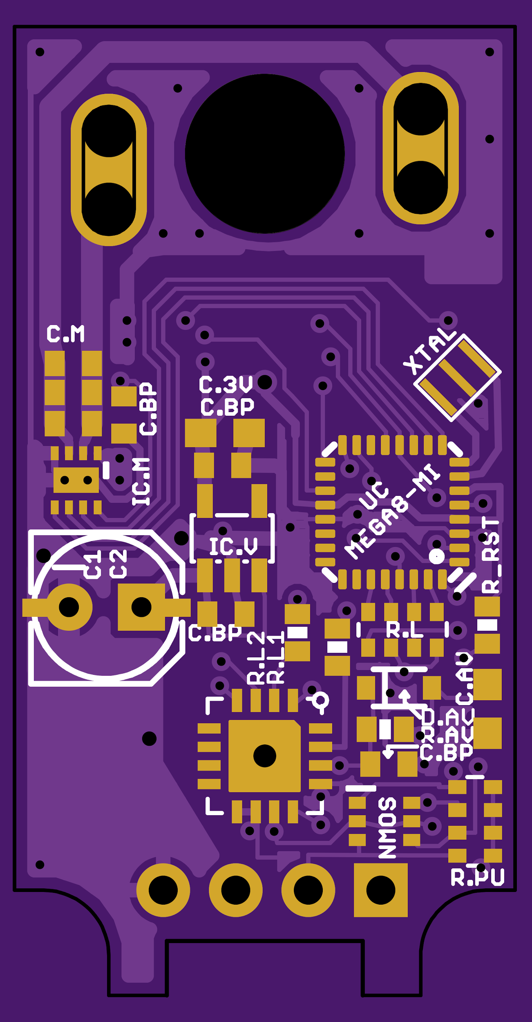
Assembly: SMD Placement
Expect to bump them a bit
Usually pretty forgiving
Start with hard-to-reach parts
Stuff in center, tight fit, etc
Go to “easy” parts
End with large or finicky footprints
BGA, TQFP, etc

Slide 57
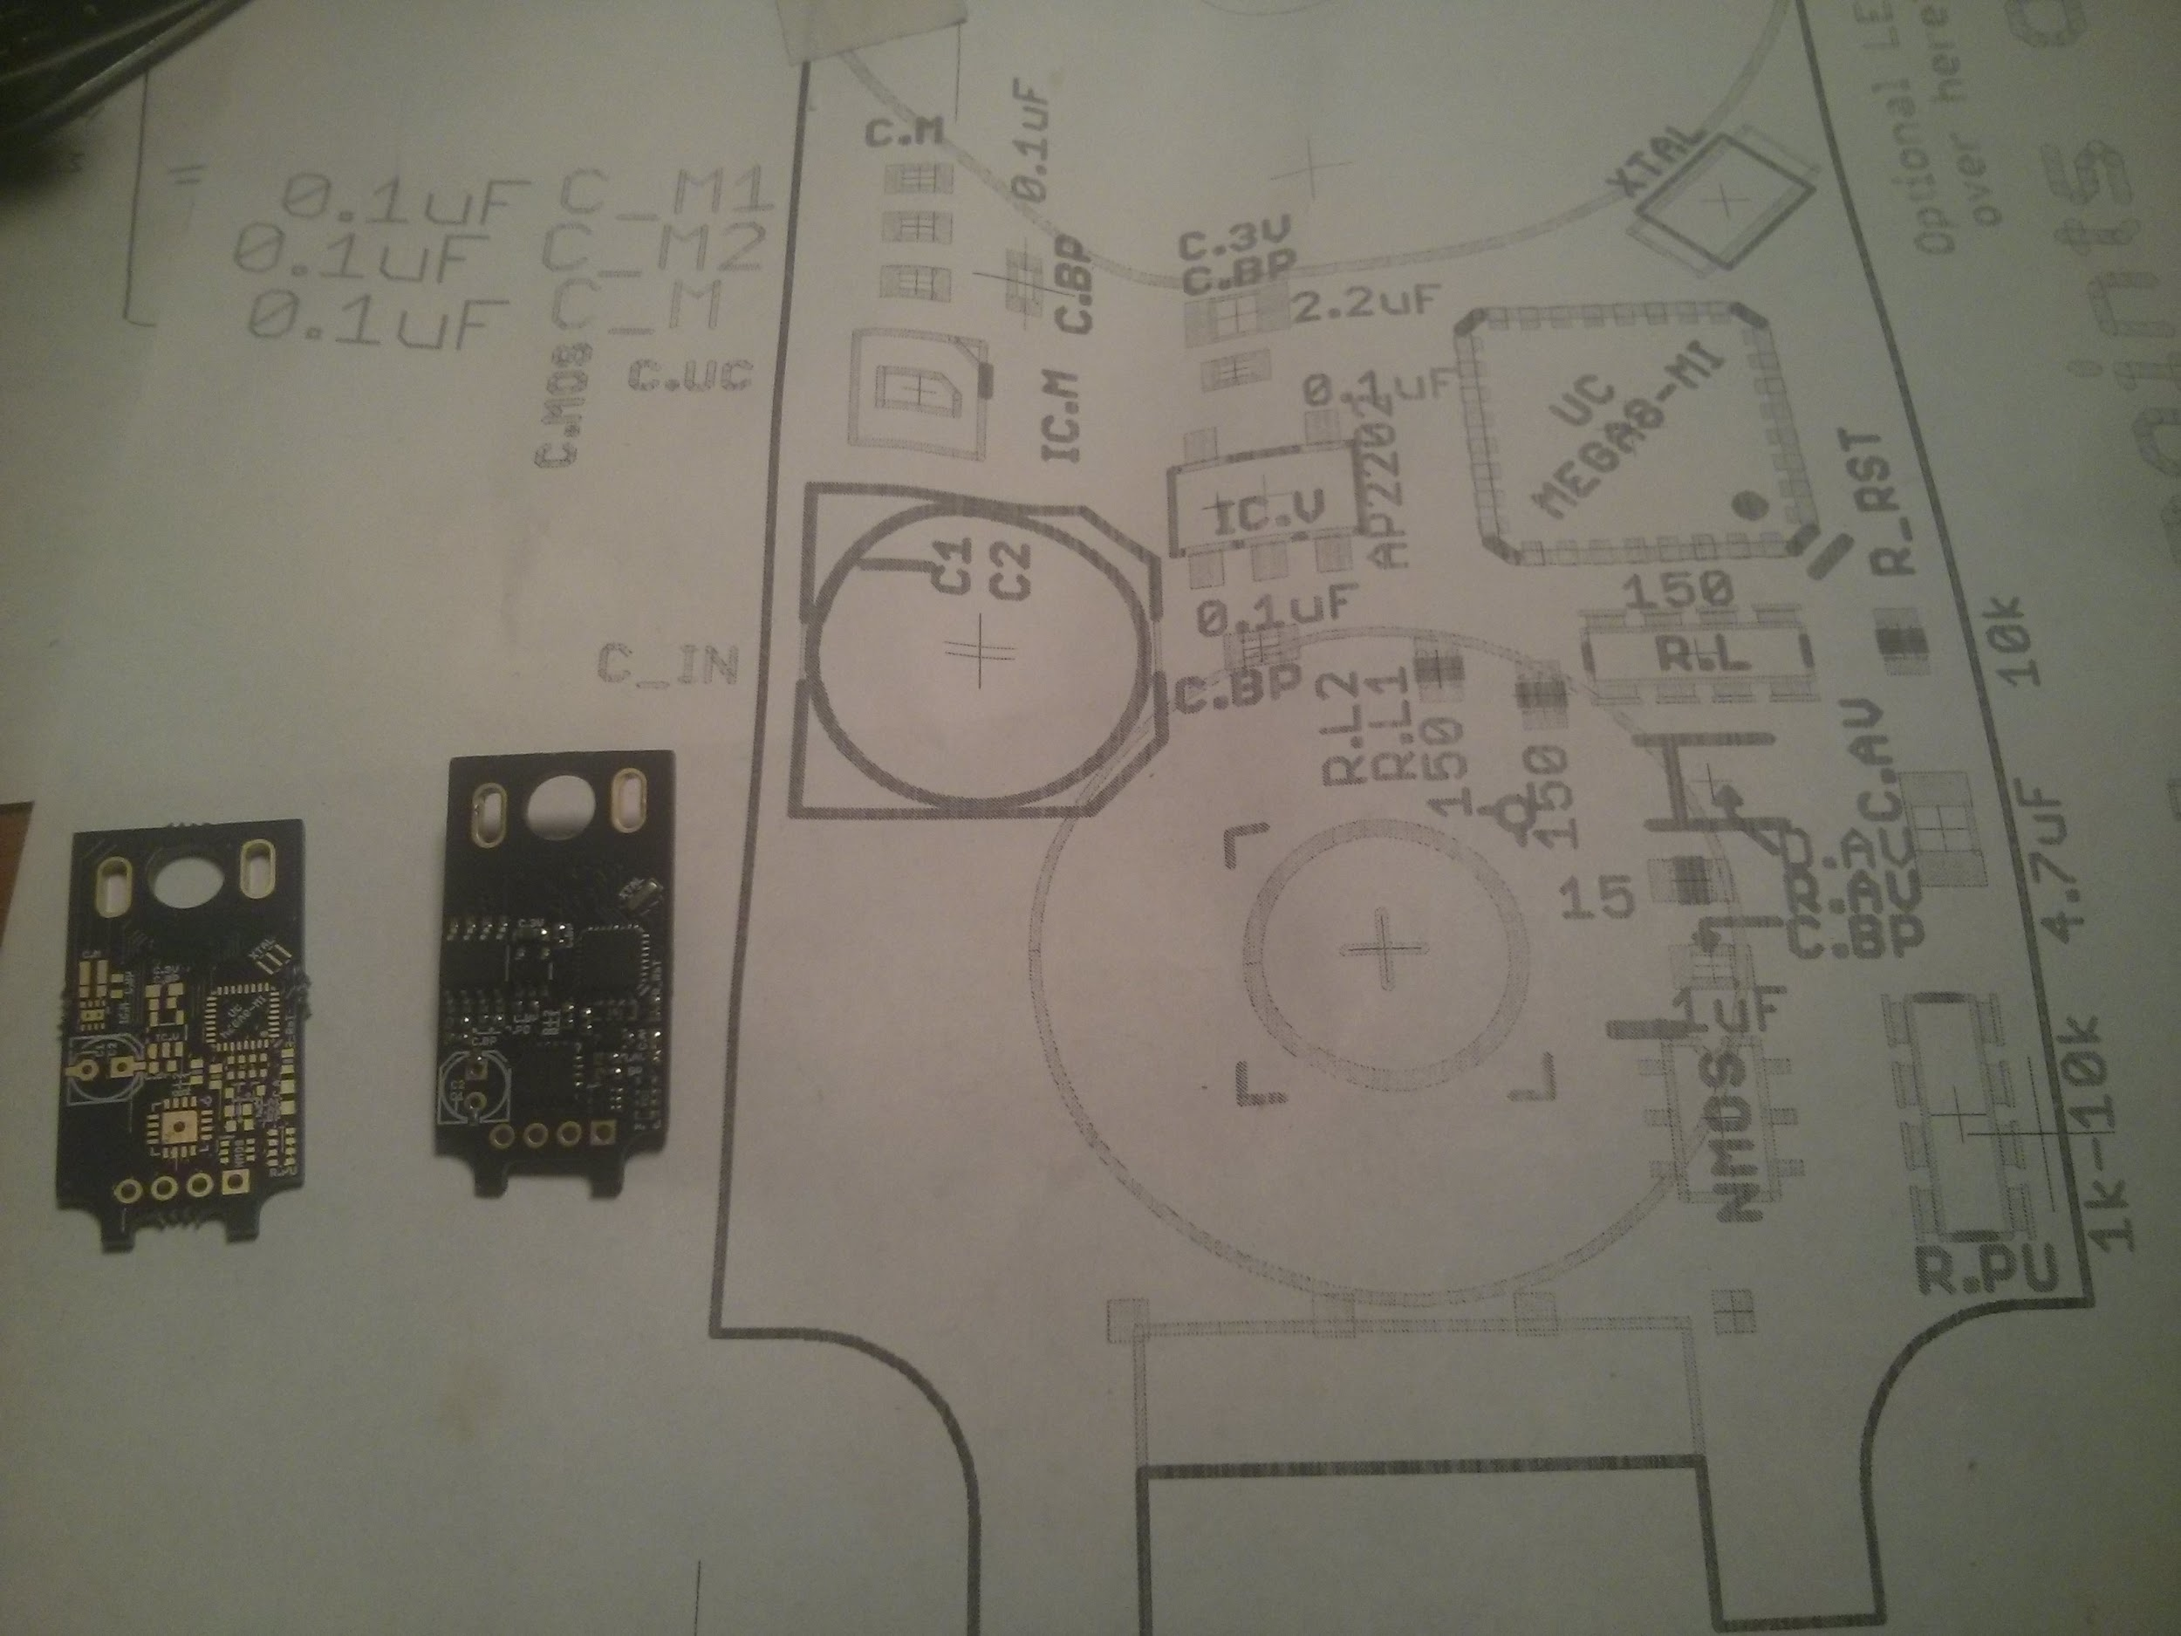
Assembly: Planning BOM
Giant printout
Include values, names, notes
Parts list
Notes:
Figure out your assembly order
Pull parts out of the box, and place on any/all components on the large printout.
This gives a good check for values and names, quantities and placement on the PCB
Transfer from paper to any boards
Alternatively, you can get a large printout that has line-by-line printouts
Tricky to read
lots of double-checking
Gives me a headache.

Slide 58
Assembly: Reflow Procedure
Minimum required items:
Old pan
IR Thermometer
My home procedure
Medium til around 250F-300F (flux melts into matte pools)
High until solder flows (~250F)
Nudge parts if needed (careful!)
Remove pan from burner
Notes:
Not perfect, but it works. Try one at a time until you get a feel for it
Produces poor temperature profiles, so not ideal for BGA parts, or sensitive components with precise assembly needs.

Slide 59
Assembly: Through-Hole
Lots of good video tutorials
Mostly practice
Lots of flux
Pro tips:
Poster Tack is your friend.
Holds board firmly to table
Blob around loose parts
Sparkfun Locking headers = <3 https://www.sparkfun.com/tutorials/114

Slide 60

Questions!

